Slide 1

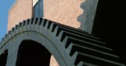
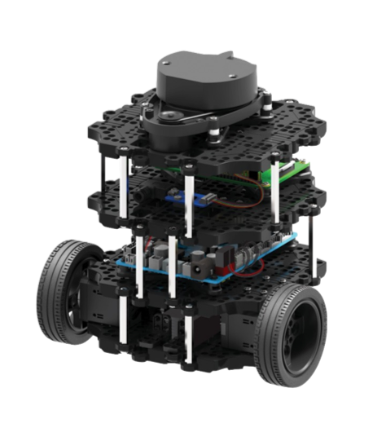
System to detect and localise garbage on the floor
By: Raúl Lázaro Sánchez
Valladolid, Spain
Promoters:
Wim Claes
Eric Demeester
David De Schepper

Slide 2
Content
Introduction
Methods
Results
Conclusion and future work
ERASMUS impression

Slide 3

Introduction
Colruyt Group
Biggest chain of supermarkets
Cleaning process of floors after closing time
Manual process
Time consuming
Purpose
Detection and localisation of garbage on the floor
Mounted on an autonomous mobile platform
ROS compatible

Slide 4

Introduction
Robot Operating System
Open source software framework
Runs on top of Linux
Contains libraries for robotic applications

Slide 5
Methods
Map building
Garbage detection based on vision
Calibration of camera and laser
Marking on map

Slide 6
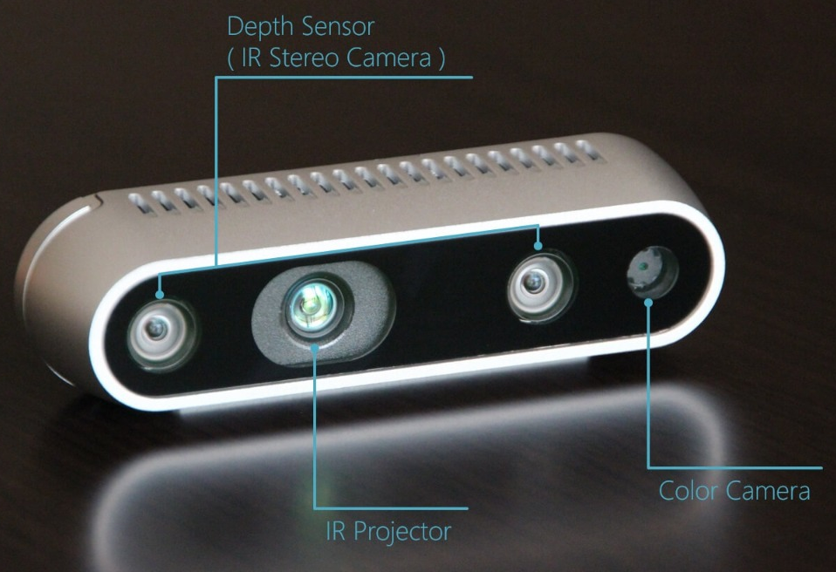
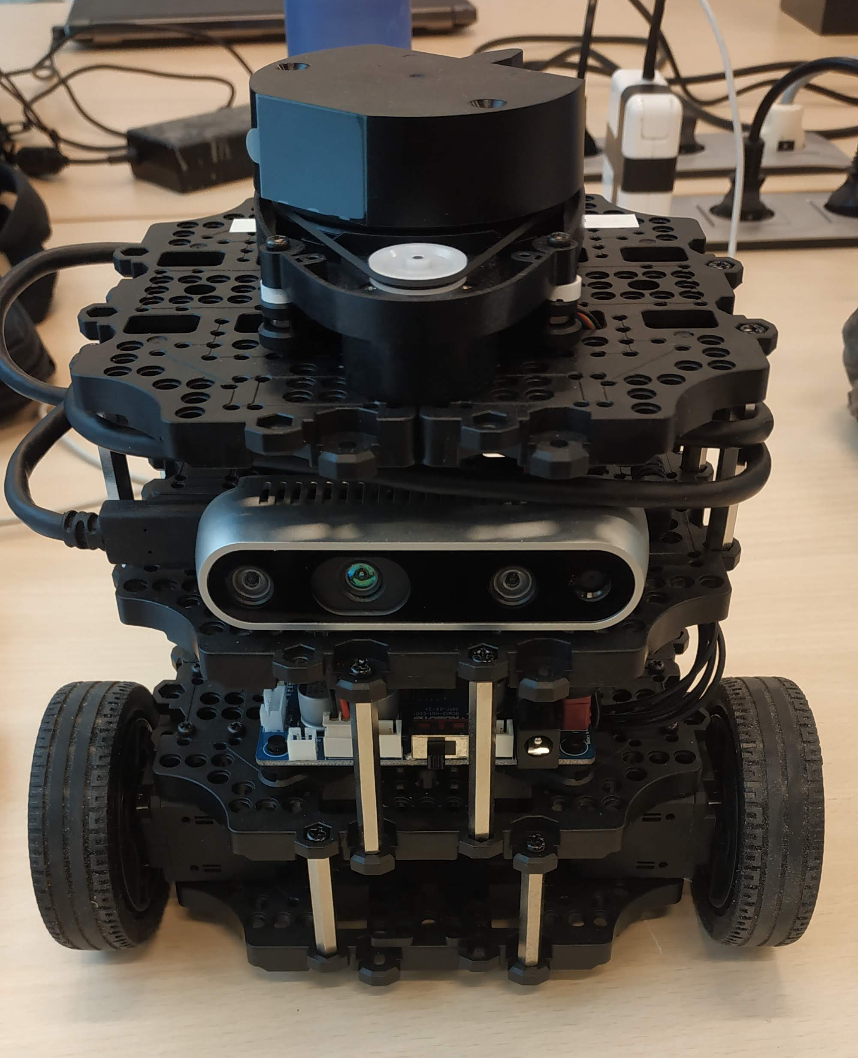
Preparation of the robot
RGBD Camera
Intel Realsense d435
Placement and installation.
Problems Raspberry Pi:
Lack of RAM
Swap partition
USB connection
Lower the FPS and resolution

Slide 7

Map building with Turtlebot
Mapping of Colruyt store

Slide 8
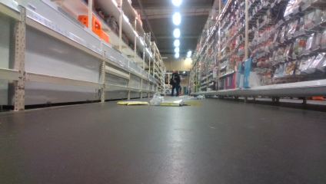
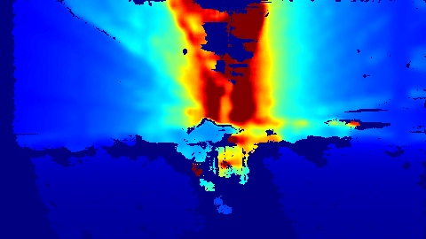
Analysis of the information obtained
Colour image
The lower half is the most interesting
Uniform color of the floor
Problem with reflections
Depth image
Problem range

Slide 9

Garbage detection based on vision
Two objectives:
Recognition of objects different to the ground (colour based)
Remove brightness
Testing on Matlab for simplicity and speed
Captures of the recorded video

Slide 10
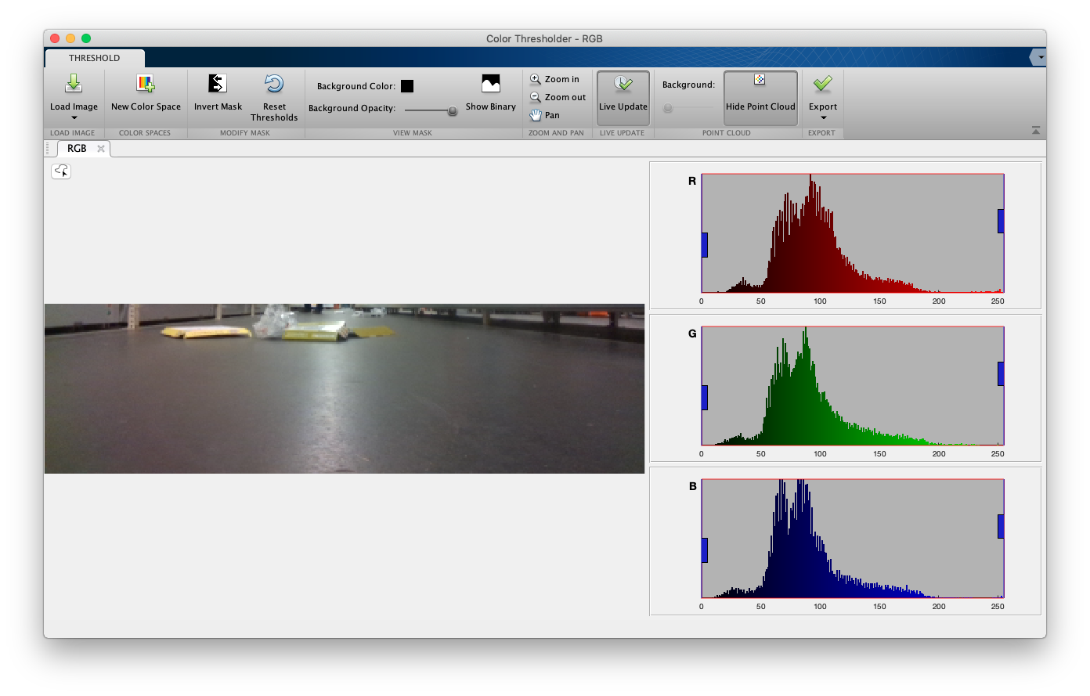
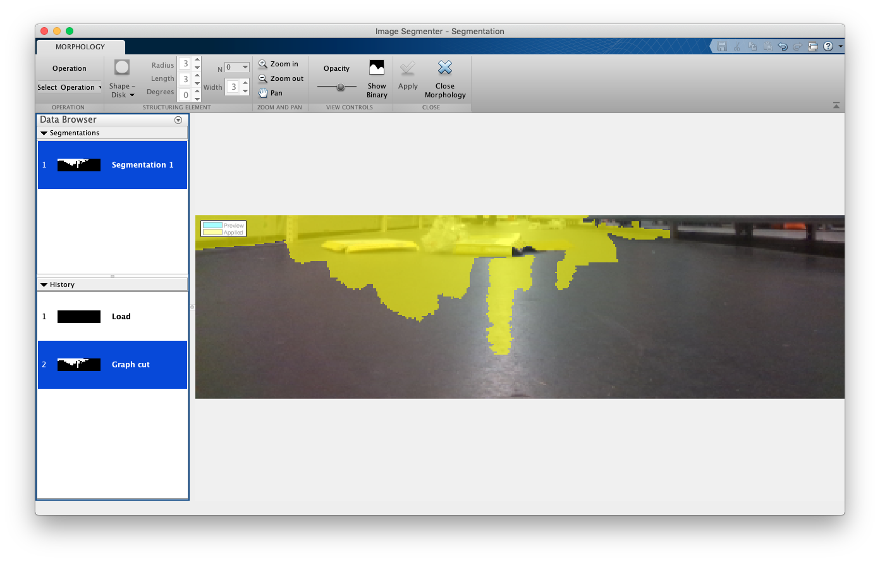
Garbage detection based on vision
Matlab apps:
Colour threshold
Different space of colours (RGB)
Histogram
Image segmenter
Morphological operations

Slide 11
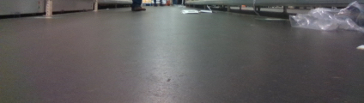

Preliminary results
Colour space threshold around 200:
Notes:
perfect threshold

Slide 12
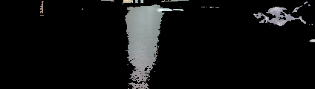
Preliminary results
Lower threshold (<200):
Notes:
lower threshold

Slide 13





Remove brightness
Morphological operations
Kernel operations based on input image
Few examples
Chosen operation: Top Hat
Original | Erosion | Dilation | Opening | Top Hat

Slide 14
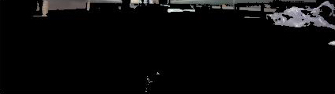
Remove brightness
Top hat masked image:

Slide 15
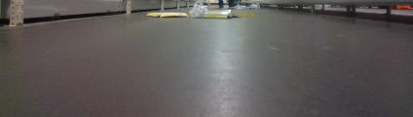

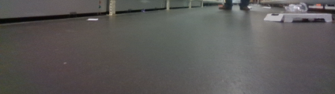

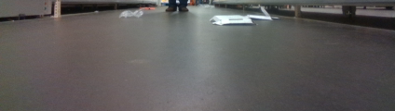

Online implementation
Libraries of OpenCV in combination with ROS

Slide 16
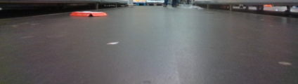

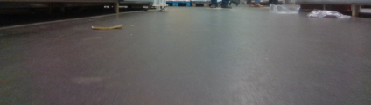

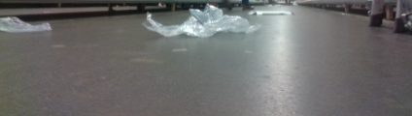

Online implementation
Libraries of OpenCV in combination with ROS

Slide 17
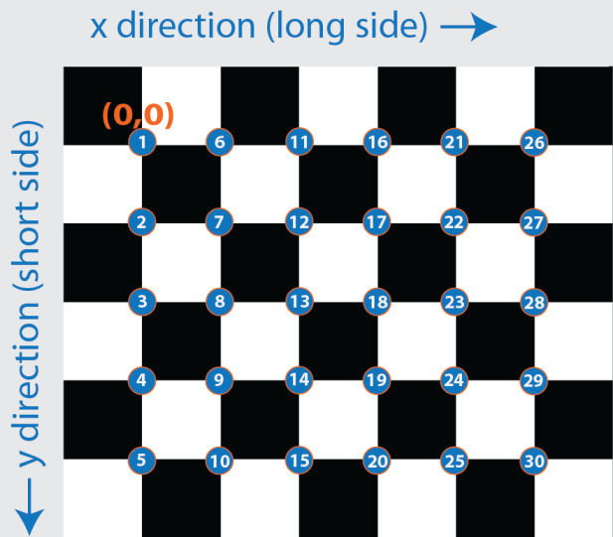
Camera calibration
Transformation of coordinates in the robot frame
Combining laser and camera data
Checkerboard-camera calibration:
Matlab toolbox to calibrate camera:
Position of camera relative to checkerboard
Low error (± 0,5 mm)

Slide 18
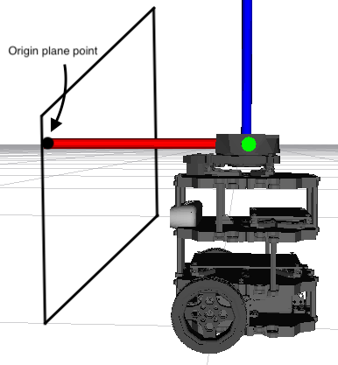
Camera calibration
Checkerboard-laser transformation:
Matching the origin of checkerboard and laser
Plane parallel to the robot
Delta X = laser measurement
Delta Y = 0
Delta Z = 0
Error ruler and laser (± 1 mm)

Slide 19
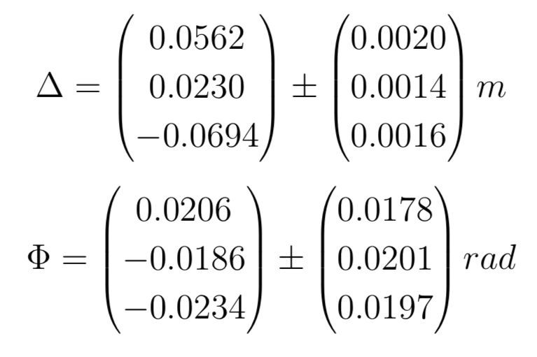
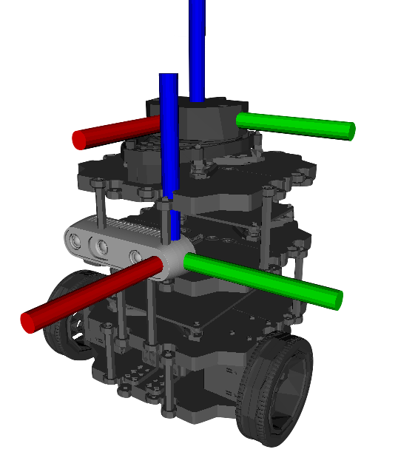
Camera calibration
The final camera-laser transformation would be:

Slide 20
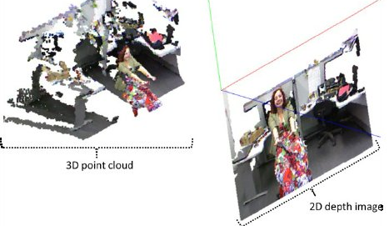
Garbage positioning
Point cloud data:
Two types:
Unorganized, is 1 row array of points. (default)
Difficult to calculate the point-pixel relation
Organized point cloud data, 2D array of points with the same size of the color image
Point-pixel relation is known

Slide 21
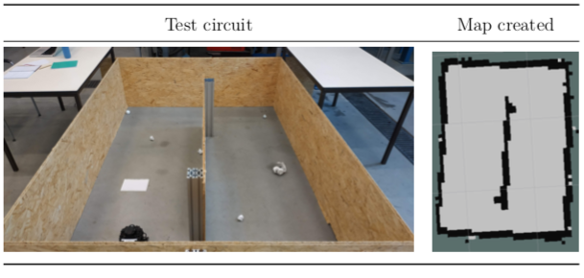
Results
Create a test circuit in ACRO:
Recreate the environment
Scan twice (garbageless, with garbage)

Slide 22
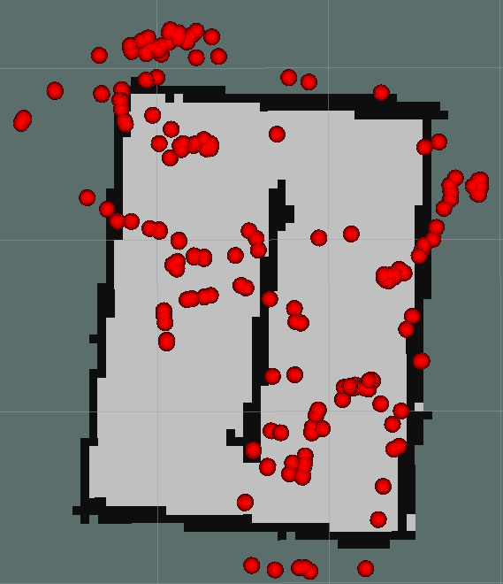
Results
Online procedure (robot and camera)
First results:
Automated garbage marking
Shortcomings:
Noise of the point cloud
Lack of power of the Raspberry Pi

Slide 23
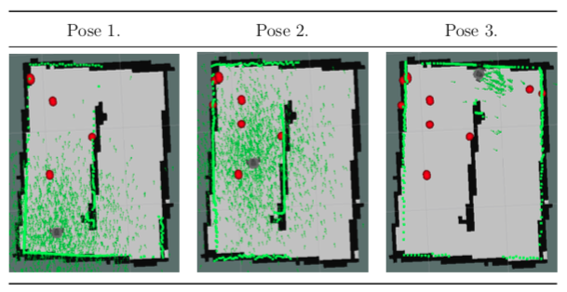
Results
Semi-online procedure:
Robot movement and vision not at the same time

Slide 24
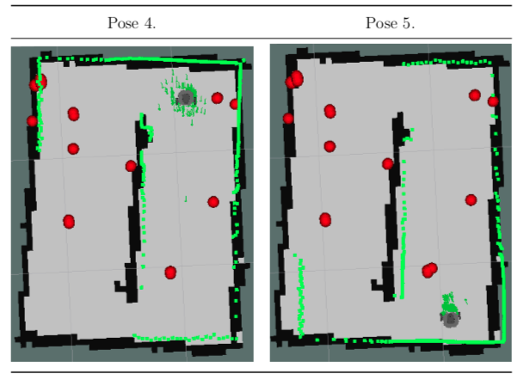
Results
Semi-online procedure:
Robot movement and vision not at the same time

Slide 25
Conclusion
Recognition of objects in dynamic environment
Positioning and marking objects on a map
Calibration of a camera position
Autonomous approach to garbage localisation
I have learned:
ROS and Linux
About robots and sensors
About cameras
Reinforced my knowledge in C++ and OpenCV

Slide 26
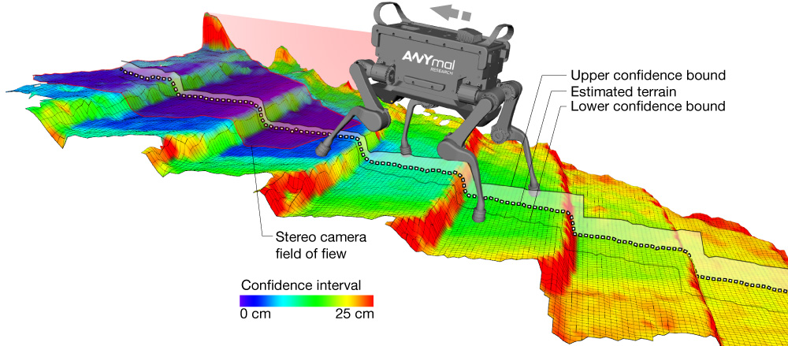
Future work
Creation of elevation maps:
Remove parts of the image that are fixed objects:
Evaluate PCL position of each pixel
Adapt the algorithm to be used in any environment
Other vision techniques
Deep learning

Slide 27
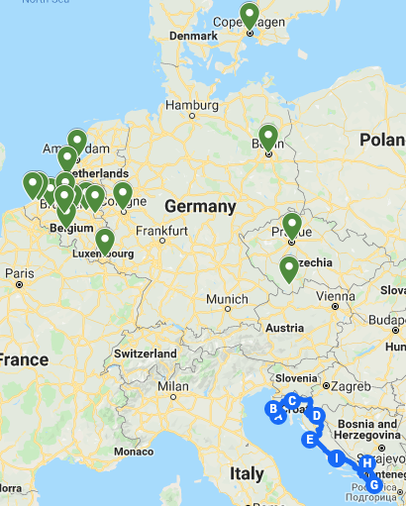

ERASMUS impression
9 Countries
+26 Cities

Slide 28
Thank you for your attention!
Any questions?

